Slide 1

Open-Source Information Architecture Design
Using the Tools You Have to Conduct Card Sorting and Tree Testing
Shannon McHarg
UX Designer
Office of Natural Resources Revenue

Slide 2
Overview
Card sorting and tree testing are useful for organizing websites and learning how users think.
Unfortunately, the most popular tool for conducting those studies doesn’t have a government terms of service. This makes it difficult to get approval to use within a federal agency.
We didn’t let that stop us.

Slide 3

About ONRR.gov

Slide 4
ONRR.gov problem statement
Companies pay to produce natural resources on federal lands, Indian lands, and the Outer Continental Shelf. They need to access timely and accurate information to meet complex regulatory requirements. These requirements include reporting production and paying the required royalties and other revenues. The Office of Natural Resources Revenue collects, verifies, and disburses those revenues.
Native Americans and the public need to understand their revenues and ensure we meet our trust responsibilities. ONRR should provide access to resources and clear communication to help this understanding.

Slide 5
ONRR.gov vision
We communicate the role of the Office of Natural Resources Revenue. We deliver trusted and easy to use information and customer service. This enables companies who lease federal and Indian lands to accurately report production and pay revenue due.

Slide 6
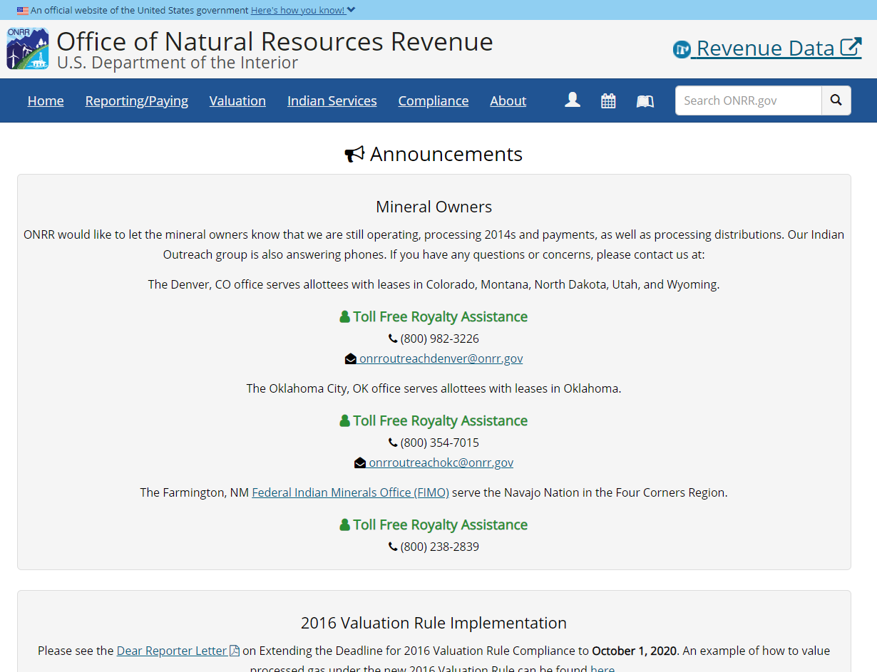
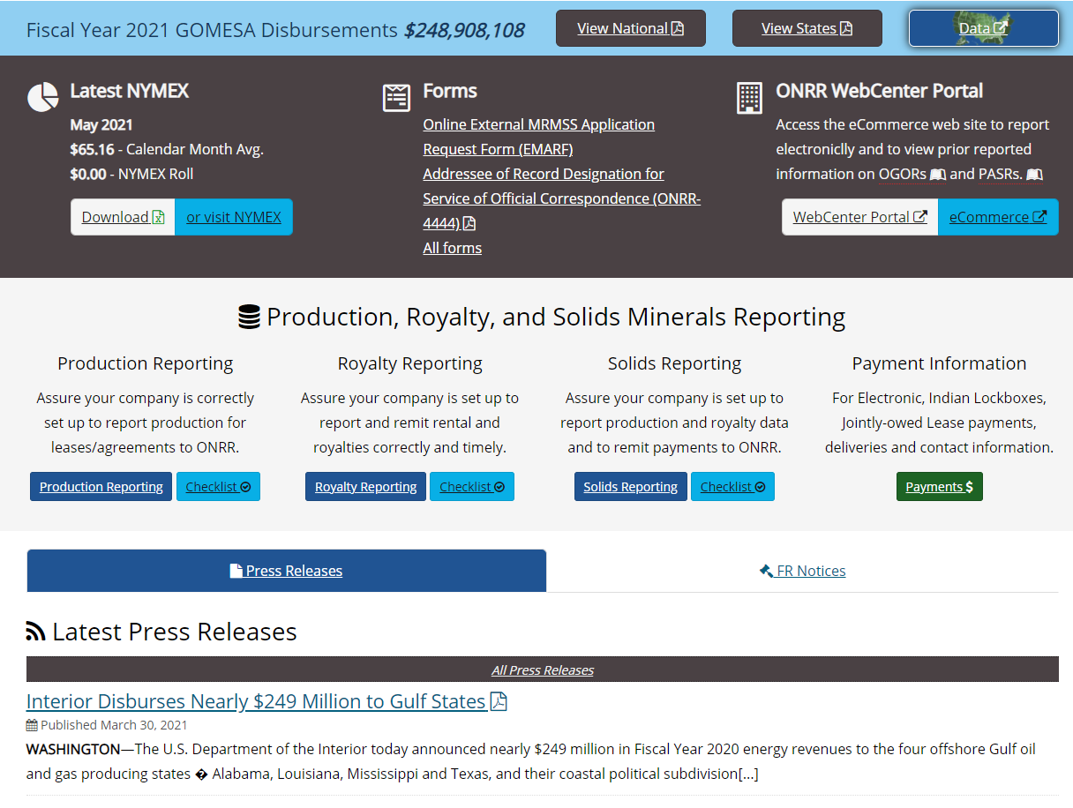
ONRR.gov current state
https://www.onrr.gov/

Slide 7
Who uses ONRR.gov
Oil, gas, mineral industry
Production reporter
Royalty reporter/payor
Solids reporter/payor
New reporter
ONRR customer service rep
Resource owner (tribe, Individual Indian Mineral Owner (IIMO))
Inquisitor

Slide 8
Why redesign ONRR.gov’s information architecture?
ONRR.gov hadn’t had any user research done on it when we inherited it.
We had already done user interviews focused on task analysis and issues with the current site.
We wanted to understand how users think about the content and how they would organize the information presented.

Slide 9
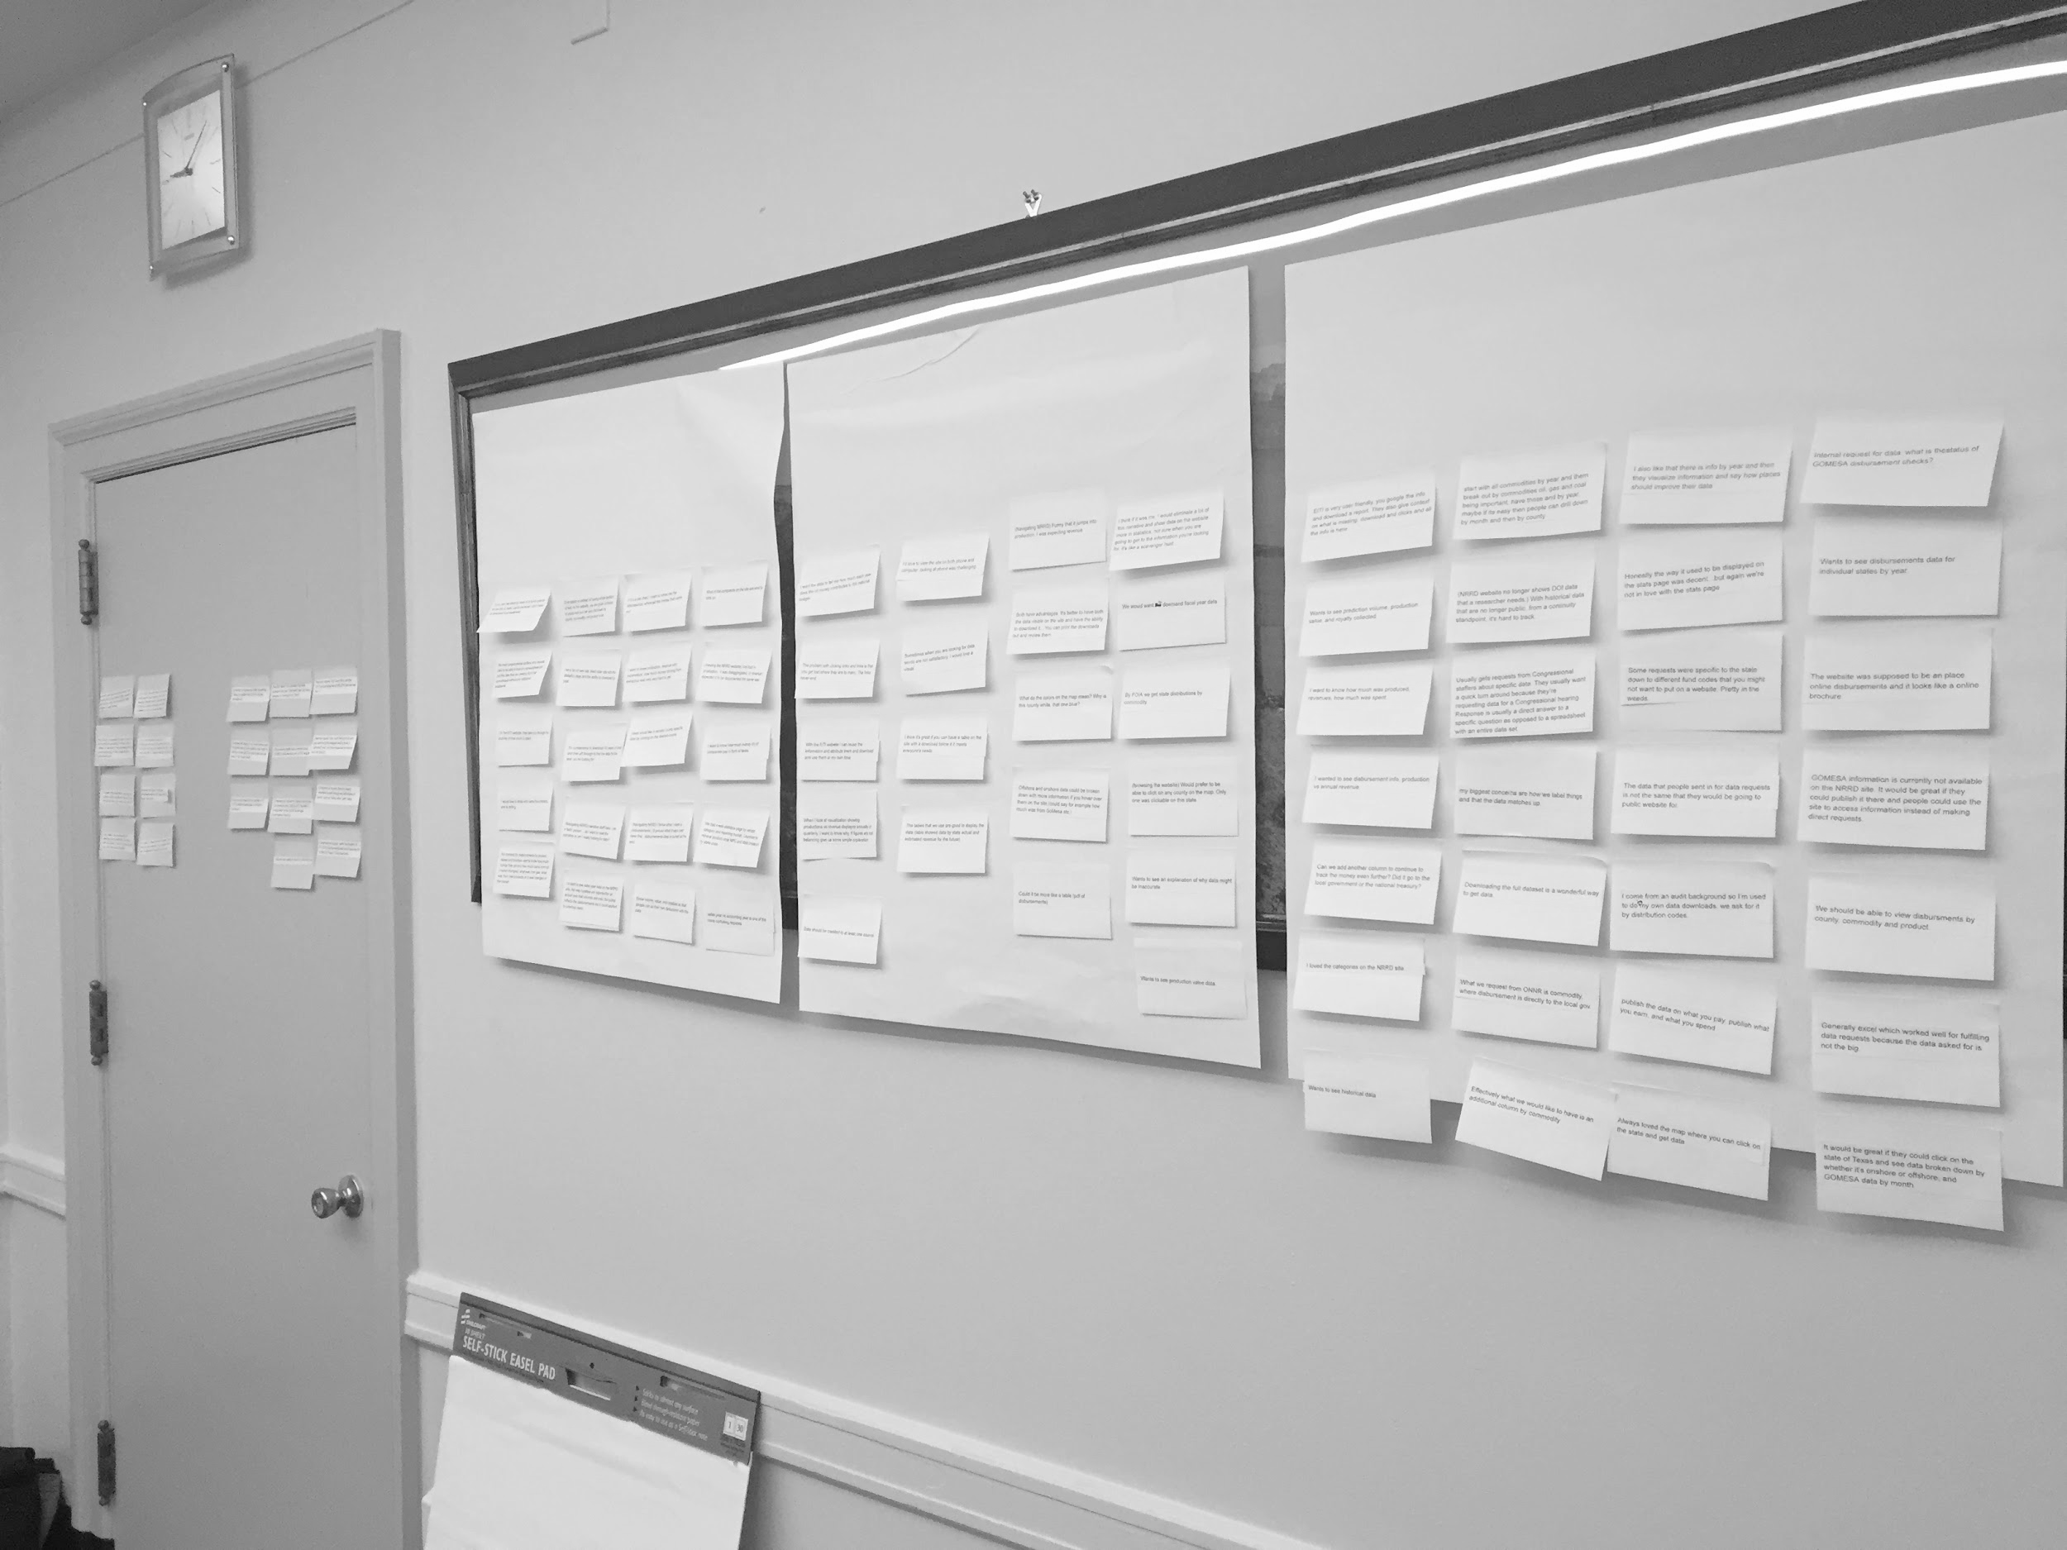
Information architecture process

Slide 10
Our process
Open card sorting
Closed card sorting
Tree testing
Content analysis & stakeholder review (where we are now)
Usability testing (next step)

Slide 11

Open card sorting

Slide 12
How we got to open-source card sorting
We were hesitant to do a card sort because we had heard about the terms of service issues with the commercial software.
One of our interns mentioned an article about using a task management product to conduct a card sort.
We use GitHub to manage our work, so this article got us thinking about how we might be able to do card sorting using GitHub. GitHub is FedRAMP authorized and has some of the same functionality as the tool used in the article.
Note: Nothing in this presentation is an endorsement of GitHub or any other tool.

Slide 13

Feasibility

Slide 14
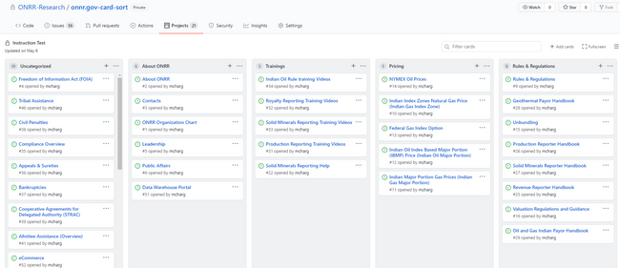
Getting Started
We started by testing out whether we could simulate the environment of dragging cards to categories. We were able to do that by using the project boards available in GitHub.
Image: Screenshot of our test organizing cards into categories using a GitHub project.

Slide 15
One caveat
We ended up moderating sessions because GitHub requires participants to enter a code sent via email, even when two-factor authentication is off.

Slide 16
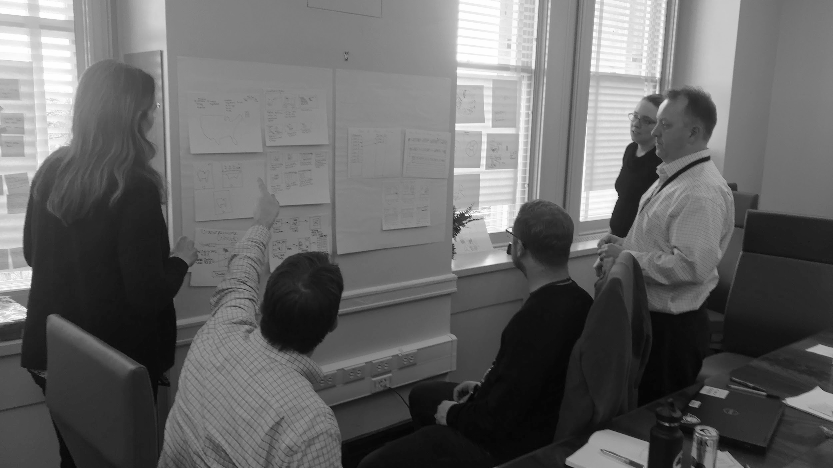
Study prep

Slide 17
Card selection
We created 56 cards using the issue function in GitHub.
We picked the cards based on:
analytics that show how often content was used over the last fiscal year.
search terms that indicate content users have a difficult time finding.
balancing to make sure the cards were a good representation of the content we have on the site.
We recruited participants from people who we know use the site with a mix of participants from industry and internal users from our agency.

Slide 18
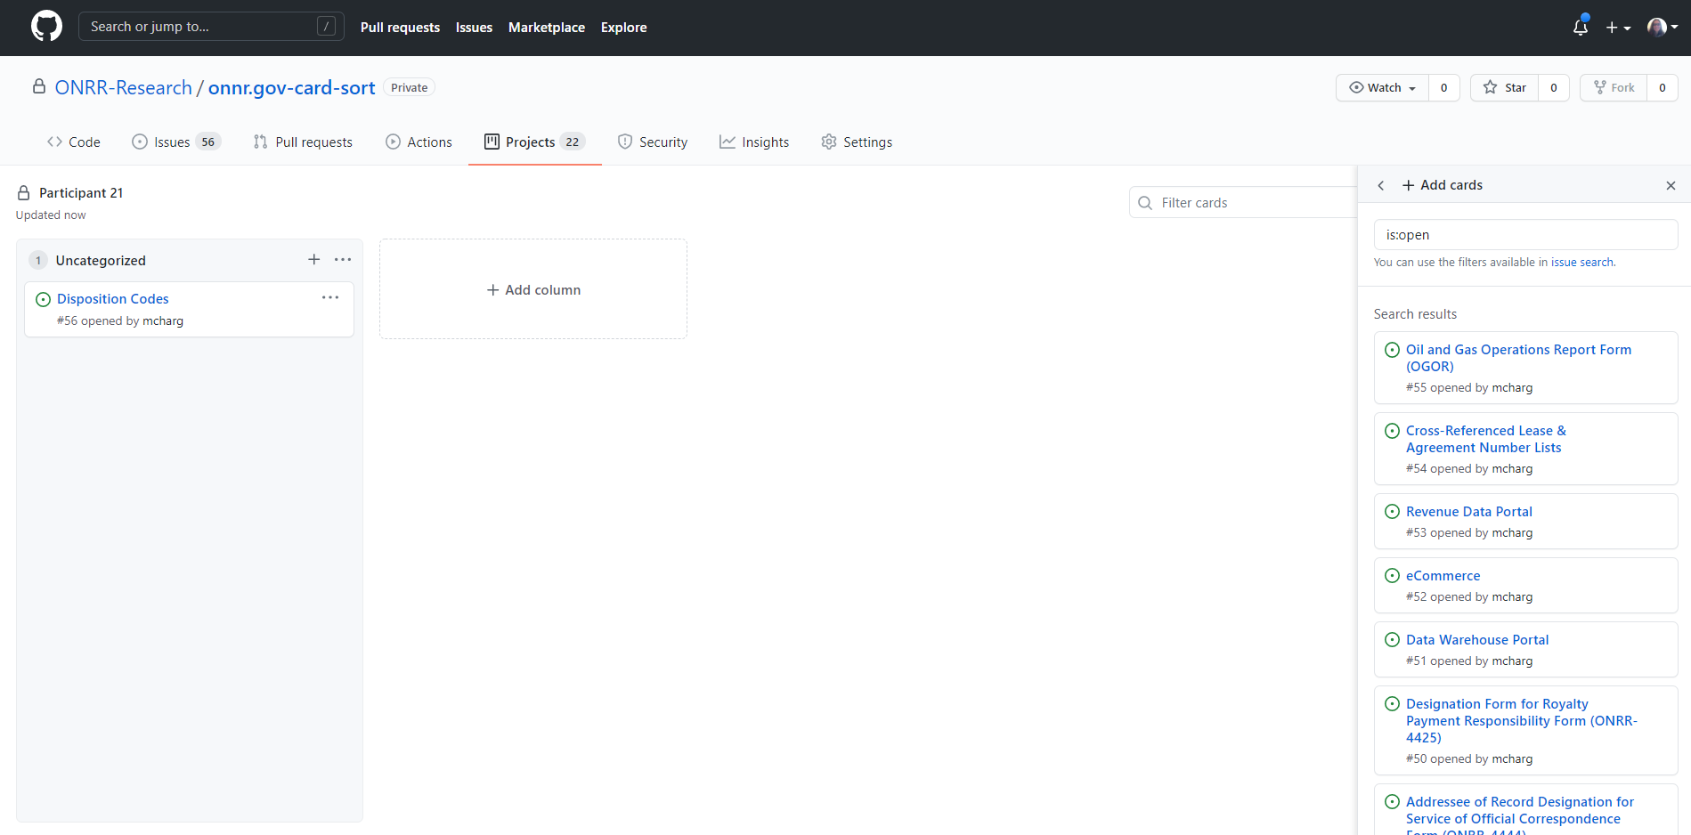
Setting up for each participant
We created a new GitHub project for each participant. We created an Uncategorized category and added each card to the project in that category.
Image: Screenshot showing how we added cards to the projects for each participant.

Slide 19
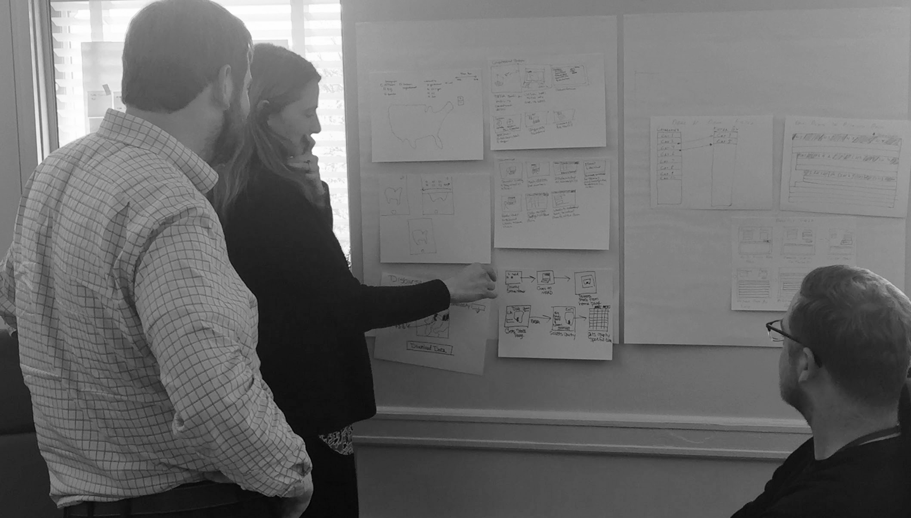
Conducting the study

Slide 20
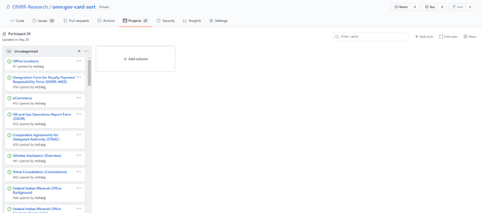
Default view
Participants started out with a list of cards in an “Uncategorized” category. We explained how to add new columns for each category the participant wanted to create.
Image: Screenshot showing the default view participants saw in GitHub with a list of uncategorized cards and the ability to add a new column.

Slide 21
As participants sorted, we had them:
think out loud and explain how they were organizing the content.
ask questions if they didn’t understand what a card was.
tell us if cards were missing for things they use the site for and would like to add to a category.
leave any cards that they didn't understand in the Uncategorized category.

Slide 22
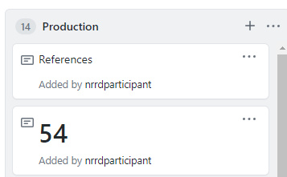
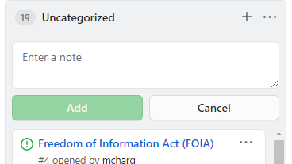
Notes feature
As we interacted with participants, we learned about the Notes feature. It allowed participants to add subcategories, add new cards, and put cards in multiple places.
Image: Screenshot showing the note function in GitHub.
Image: Screenshot of a References card added using the note function and card #54 added to a second category.

Slide 23

Analysis
Notes:
26:00 – 30:00 Real outcomes from mock testing

Slide 24
Card sort analysis
One thing GitHub doesn't do is analysis.
We went back to this trusty old Boxes and Arrows column and created a modified version of their analysis spreadsheet to meet our analysis needs.
You can download our modified spreadsheet template (xls).

Slide 25
Analysis by participant
Create a worksheet for each participant with their raw organization of the cards into categories.
Add the participant’s organization as a column in the raw results worksheet with the category each card was put in.
Add the participant’s list of categories to the categories tab. This allows you to see all the organizations side by side.

Slide 26
Individual participant organization
Note: This was an internal participant who gave us permission to use their individual data in this presentation.
Uncategorized | About ONRR | About ONRR > Outreach and impact | Compliance | Appeals and Enforcement | Valuation > Rules and Regulations | Reporting | Reporting > Forms | Publication Pricing | Resources | Valuation > Indian Oil and Gas | Valuation > Federal Oil and Gas | Valuation > Solids | Valuation > Geothermal
Freedom of Information Act (FOIA) (4) | About ONRR (2) | Indian Energy Service Center (IESC) (45) | Compliance Overview (35) | Late Payment & Underpayment Interest Tables (Late Payment Interest) (24) | Rules & Regulations (9) | Royalty Reporting Help (21) | Oil and Gas Operations Report Form (OGOR) (55) | Indian Major Portion Gas Prices (Indian Gas Major Portion) (11) | Federal Indian Minerals Office Contacts (Contact Us) (43) | Royalty Reporting Help (21) | Royalty Reporting Help (21) | Royalty Reporting Help (21) | Geothermal Payor Handbook (28)
 | Leadership (5) | Federal Indian Minerals Office- Background (44) | Civil Penalties (38) | Bankruptcies (37) | Valuation Regulations and Guidance (16) | Revenue Reporter Handbook (25) | Report of Sales and Royalty Remittance Form (MMS-2014) (48) | Indian Oil Index Based Major Portion (IBMP) Price (Indian Oil Major Portion) (12) | Unbundling (15) | Oil and Gas Indian Payor Handbook (29) | Unbundling (15) | New Solid Minerals Reporters Checklist (19) | Royalty Reporting Help (21)
 | ONRR Organization Chart (1) | Cooperative Agreements for Delegated Authority (STRAC) (39) | Late Payment & Underpayment Interest Tables (Late Payment Interest) (24) | Civil Penalties (38) | Unbundling (15) | Disposition Codes (56) | Designation Form for Royalty Payment Responsibility Form (ONRR-4425) (50) | Indian Index Zones Natural Gas Price (Indian Gas Index Zone) (10) | Royalty Reporting Help (21) | Indian Oil Rule training Videos (34) | Federal Gas Index Option (13) | Solid Minerals Reporting Training Videos (33)
 | Contacts (3) | Data Warehouse Portal (51) | Bankruptcies (37) | Appeals & Sureties (36) |  | eCommerce (52) | External MRMSS Application Request Form (EMARF) (47) | NYMEX Oil Prices (14) | New Production Reporter Checklist (17) |  |  | Solid Minerals Reporter Handbook (27)
 | Federal Indian Minerals Office Contacts (Contact Us) (43) | Press Releases (8) |  | Treasury Referrals (40) |  | Payments (23) | Addressee of Record Designation for Service of Official Correspondence Form (ONRR-4444) (49) |  | New Royalty Reporter/Payor Checklist (18) |  |  | Solid Minerals Reporting Help (22)
 | Office Locations (7) | Tribal Consultation (Consultation) (42) |  |  |  |  |  |  | Production Reporter Handbook (26)
 |  | Revenue Data Portal (53) |  |  |  |  |  |  | Production Reporting Help (20)
 |  | Public Affairs (6) |  |  |  |  |  |  | Reporter Letters (30)
 |  |  |  |  |  |  |  |  | Tribal Assistance (46)
 |  |  |  |  |  |  |  |  | Production Reporting Training Videos (31)
 |  |  |  |  |  |  |  |  | Allottee Assistance (Overview) (41)
 |  |  |  |  |  |  |  |  | Federal Indian Minerals Office- Background (44)
 |  |  |  |  |  |  |  |  | Royalty Reporting Training Videos (32)
 |  |  |  |  |  |  |  |  | Cross-Referenced Lease & Agreement Number Lists (54)
 |  |  |  |  |  |  |  |  | Indian Energy Service Center (IESC) (45)

Slide 27
Analysis across participants
Normalize the categories by grouping similar categories across participants and coming up with a normalized name to use for the category.
Find and replace the raw category names with the normalized category names.
Look at what categories each card was placed in.
Come up with a structure that uses the most commonly used categories.

Slide 28
Overall structure (11 participants)
Key
High agreement (>80%)
Low agreement (<30%)
Tie for most used category (thick border)
Home/Header | Production | Royalty | Solid Minerals | Reporting | New Reporter Setup | Training & Resources | Indian | Payment | Forms | Enforcement & Appeals | ONRR Communication | About ONRR | Misc
Revenue Data Portal (53) (30%) | Production Reporting Help (20) (50%) | Royalty Reporting Help (21) (55%) | New Solid Minerals Reporters Checklist (19) (40%) | Disposition Codes (56) (50%) | Addressee of Record Designation for Service of Official Correspondence Form (ONRR-4444) (49) (30%) | Geothermal Payor Handbook (28) (50%) | Tribal Consultation (Consultation) (42) (80%) | Payments (23) (50%) | Addressee of Record Designation for Service of Official Correspondence Form (ONRR-4444) (49) (30%) | Appeals & Sureties (36) (60%) | Public Affairs (6) (30%) | ONRR Organization Chart (1) (70%) | Compliance Overview (35) (33%)
Data Warehouse Portal (51) (27%) | Production Reporting Training & Resources Videos (31) (50%) | Royalty Reporting Training & Resources Videos (32) (55%) | Solid Minerals Reporter Handbook (27) (40%) | Cross-Referenced Lease & Agreement Number Lists (54) (44%) | Designation Form for Royalty Payment Responsibility Form (ONRR-4425) (50) (30%) | New Production Reporter Checklist (17) (44%) | Tribal Assistance (46) (80%) | Late Payment & Underpayment Interest Tables (Late Payment Interest) (24) (40%) | Designation Form for Royalty Payment Responsibility Form (ONRR-4425) (50) (30%) | Civil Penalties (38) (50%) | Press Releases (8) (30%) | About ONRR (2) (70%) | Cooperative Agreements for Delegated Authority (STRAC) (39) (33%)
eCommerce (52) (27%) | Oil and Gas Operations Report Form (OGOR) (55) (50%) | Report of Sales and Royalty Remittance Form (MMS-2014) (48) (55%) | Solid Minerals Reporting Help (22) (36%) | External MRMSS Application Request Form (EMARF) (47) (27%) | External MRMSS Application Request Form (EMARF) (47) (27%) | New Royalty Reporter/Payor Checklist (18) (44%) | Federal Indian Minerals Office- Background (44) (70%) | eCommerce (52) (27%) | External MRMSS Application Request Form (EMARF) (47) (27%) | Treasury Referrals (40) (44%) |  | Leadership (5) (70%)
 | Production Reporter Handbook (26) (45%) | Revenue Reporter Handbook (25) (45%) | Solid Minerals Reporting Training & Resources Videos (33) (36%) |  |  | Oil and Gas Indian Payor Handbook (29) (40%) | Indian Energy Service Center (IESC) (45) (70%) |  |  | Bankruptcies (37) (40%) |  | Office Locations (7) (67%)
 | Data Warehouse Portal (51) (27%) | NYMEX Oil Prices (14) (40%) |  |  |  | Solid Minerals Reporter Handbook (27) (40%) | Indian Index Zones Natural Gas Price (Indian Gas Index Zone) (10) (60%) |  |  | Freedom of Information Act (FOIA) (4) (22%) |  | Contacts (3) (45%)
 |  | Unbundling (15) (40%) |  |  |  | Reporter Letters (30) (18%) | Allottee Assistance (Overview) (41) (60%) |  |  |  |  | Public Affairs (6) (30%)
 |  | Federal Gas Index Option (13) (33%) |  |  |  |  | Federal Indian Minerals Office Contacts (Contact Us) (43) (60%) |  |  |  |  | Press Releases (8) (30%)
 |  | Valuation Regulations and Guidance (16) (33%) |  |  |  |  | Indian Major Portion Gas Prices (Indian Gas Major Portion) (11) (55%) |  |  |  |  | Rules & Regulations (9) (27%)
 |  | Designation Form for Royalty Payment Responsibility Form (ONRR-4425) (50) (30%) |  |  |  |  | Indian Oil Index Based Major Portion (IBMP) Price (Indian Oil Major Portion) (12) (55%) |  |  |  |  | Freedom of Information Act (FOIA) (4) (22%)
 |  | Data Warehouse Portal (51) (27%) |  |  |  |  | Indian Oil Rule Training & Resources Videos (34) (50%) |  |  |  |  | Reporter Letters (30) (18%)
 |  | Reporter Letters (30) (18%)

Slide 29
Differences across audiences
Categories created only by industry participants:
Geothermal
Rent payments
Contacts
Categories created only by ONRR participants:
Pricing
Regulations
Compliance
Systems

Slide 30
Recommended structure
Reporting
Training
Paying
Pricing
Indian
Enforcement & Appeals
About ONRR
Reporting Home
Production
Royalty
Solid Minerals
Geothermal
Training Home
New Reporter Setup
Handbooks
Videos
Contacts
ONRR Communication
Includes valuation, rules & regulations, and links to Data Warehouse and eCommerce and cross-references to training section.
Includes cross-references to reporting section.
Homepage should include a section with links to Data Warehouse, eCommerce, NRRD portal, reporter letters, and new reporter setup.

Slide 31
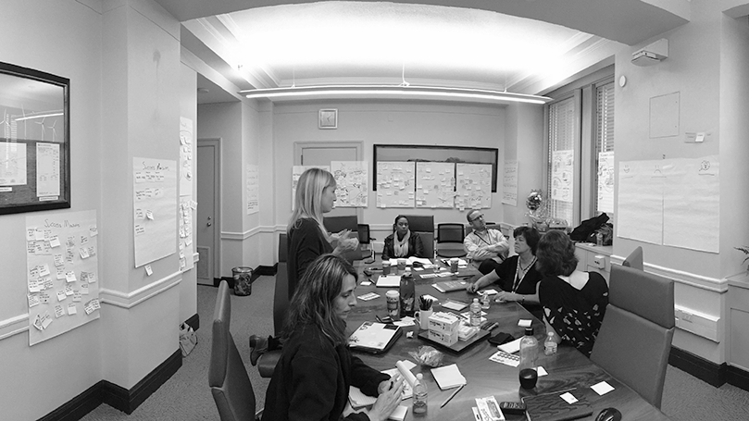
Lessons learned

Slide 32
Logistics take time
We only allocated 30 minutes per session for our participants.
It took close to 10-15 minutes for participants to log on and share their screen before they actually started sorting cards.
The number of cards overwhelmed a few participants and they asked to finish the card sort on their own time.

Slide 33
We wish we could have found more participants
We had 11 participants across two audiences.
Our analysis revealed patterns for most of the cards, but there were some cards where there was not a strong pattern.
We have a niche audience and recruiting a large enough sample for patterns is difficult.

Slide 34
Moderating sessions has benefits
Ask and answer questions
Probe into why participants organized the information the way they did
Learn about unclear card labels

Slide 35
Some of our labels were not clear
There were some cards that users did not know where to place due to the labeling or title not being clear.
Moderating the study allowed us to learn which labels weren't clear to users.
We updated the card labels to better match users’ expectations in the closed sort.

Slide 36
Feasibility of using GitHub as a tool
Overall, GitHub worked well to help us learn what we wanted to learn, and we will continue to use it in the future.

Slide 37

Closed card sorting

Slide 38
Categories we started with
Reporting | Training & Resources | Valuation | Paying | Indian | Enforcement & Appeals | About ONRR
Reporting Home | Training & Resources Home | Valuation Home | Paying Home | Indian Home | Enforcement & Appeals Home | About ONRR Home
Production | New Reporter Setup | Pricing | Late Payment Interest | Indian Services | Appeals & Sureties | Press Releases
Royalty | Handbooks | Unbundling |  | Indian Pricing | Bankruptcies | Leadership
Solid Minerals | Training Videos | Valuation Regulations |  |  | Civil Penalties | Office Locations
Geothermal | Policy |  |  |  | Cooperative Agreements | Employment
 | References |  |  |  | Treasury Referrals | Committees
 |  |  |  |  | Bankruptcies | Testimony
 |  |  |  |  |  | Anti-Harassment Program
 |  |  |  |  |  | Contact Us

Slide 39
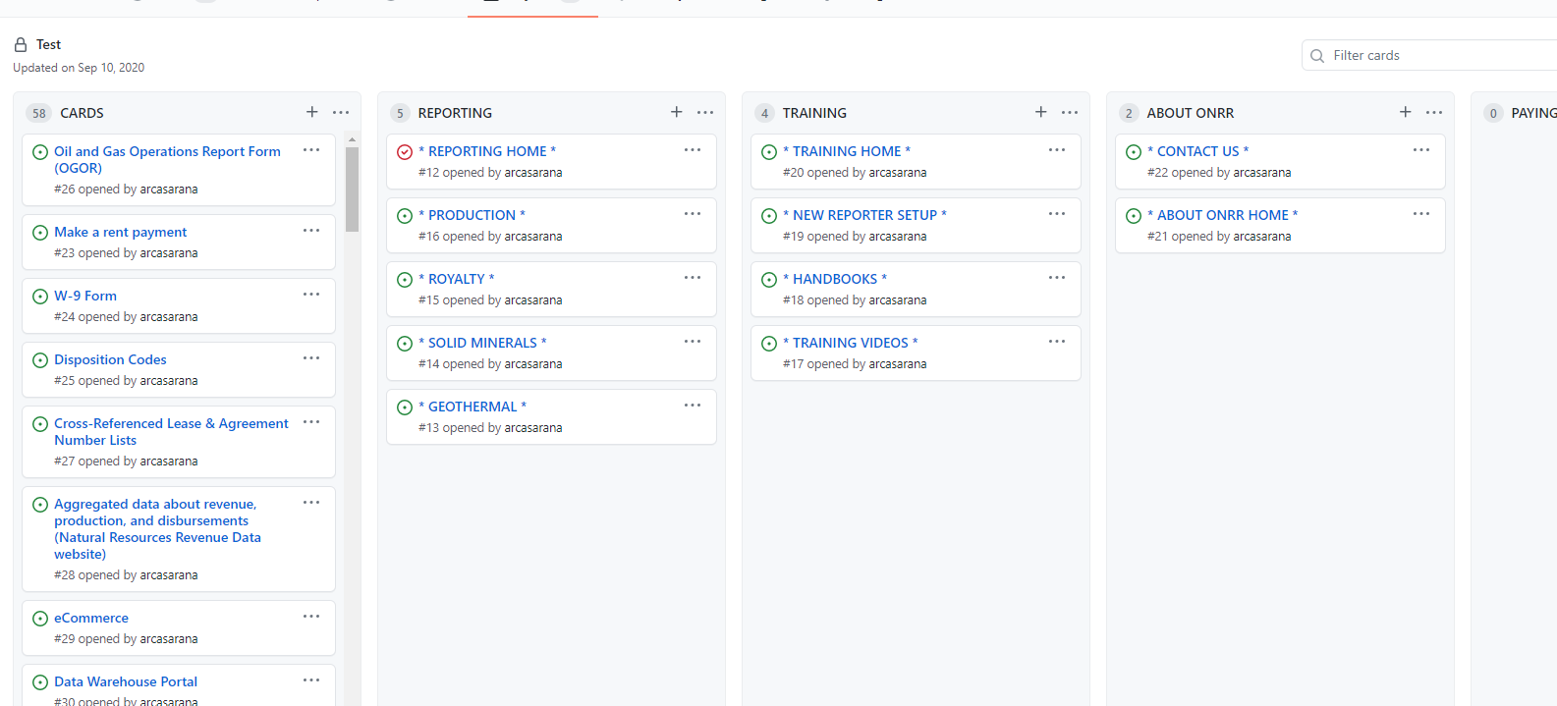
GitHub project with categories

Slide 40
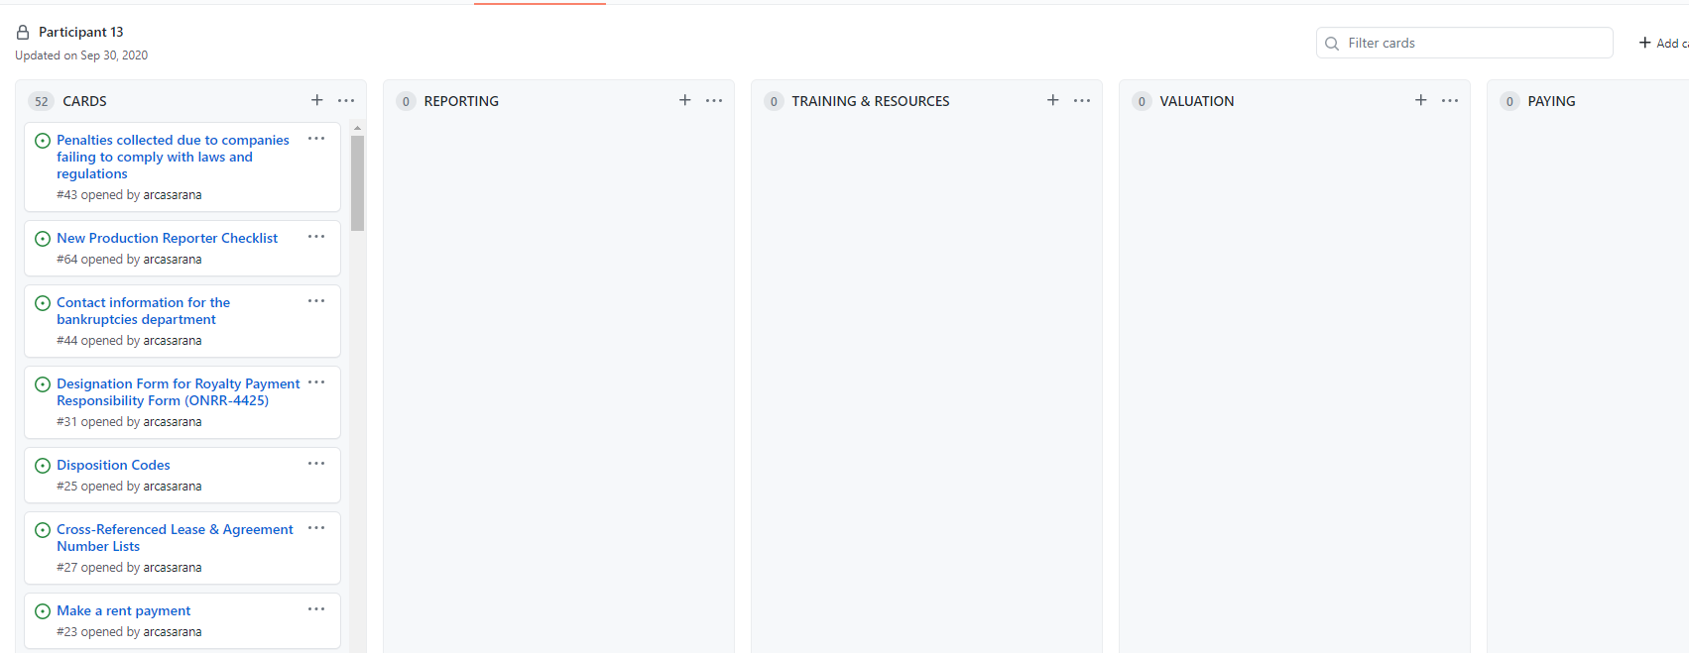
GitHub project without subcategories

Slide 41
Cards
We used 51 cards, mostly the same as the open sort, but with some revisions based on cards participants in the first study found confusing or said were missing.

Slide 42
How participants sorted (12 participants)
Reporting
Oil and Gas Operations Report Form (OGOR) (26) (100%) | Reporter Letters (51)(50%)
Report of Sales and Royalty Remittance Form (MMS-2014) (33)(91%) | Designation Form for Royalty Payment Responsibility Form (ONRR-4425) (31)(45%)
New Royalty Reporter/Payor Checklist (63)(91%) | Contact information for your representative (or for an operator you work with) (78)(45%)
New Production Reporter Checklist (64)(91%) | Take an allowance for transportation or processing costs (unbundling) (66)(45%)
Solid Minerals Reporting Help (59)(90%) | Aggregated data about revenue, production, and disbursements (Natural Resources Revenue Data website) (28) (40%)
Royalty Reporting Help (60)(82%) | Get set up to make royalty payments (58)(20%)
Production Reporting Help (61)(82%)
New Solid Minerals Reporters Checklist (62)(80%)
eCommerce (29) (82%)
Disposition Codes (25) (75%)
Cross-Referenced Lease & Agreement Number Lists (27) (67%)
Data Warehouse Portal (30) (58%)
External MRMSS Application Request Form (EMARF) (34)(58%)
Addressee of Record Designation for Service of Official Correspondence Form (ONRR-4444) (32)(55%)
Training & Resources
Production Reporting Training Videos (50)(100%) | Cross-Referenced Lease & Agreement Number Lists (27) (42%)
Royalty Reporting Training Videos (49)(100%) | Reporter Letters (51)(42%)
Solid Minerals Reporting Training Videos (48)(100%) | Addressee of Record Designation for Service of Official Correspondence Form (ONRR-4444) (32)(27%)
Production Reporter Handbook (55)(91%) | Contact information for your representative (or for an operator you work with) (78)(27%)
Revenue Reporter Handbook (56)(91%) | Disposition Codes (25) (25%)
Solid Minerals Reporter Handbook (54)(90%) | Data Warehouse Portal (30) (25%)
Geothermal Payor Handbook (53)(90%) | External MRMSS Application Request Form (EMARF) (34)(25%)
Oil and Gas Indian Payor Handbook (52)(80%) | Get set up to make royalty payments (58)(20%)
Indian Oil Rule training Videos (47)(70%)
Federal Register Notices (72)(55%)
Valuation
Find a regulation needed to value a commodity (65) (91%)
NYMEX Oil Prices (67) (73%)
Take an allowance for transportation or processing costs (unbundling) (66)(64%)
Indian Index Zones Natural Gas Price (71)(50%)
Indian Major Portion Gas Prices (70)(20%)
Paying
Make a rent payment (23) (100%)
Late Payment & Underpayment Interest Tables (57)(91%)
W-9 Form (24) (64%)
Unpaid debts referred to U.S. Treasury (41) (64%)
Designation Form for Royalty Payment Responsibility Form (ONRR-4425) (31)(45%)
Get set up to make royalty payments (58)(40%)
Indian
Tribal Assistance (35) (100%)
Indian Energy Service Center (IESC) (36) (100%)
Tribal Consultation (39) (100%)
Indian Allottee Assistance (40) (100%)
Federal Indian Minerals Office Contacts (38) (80%)
Cooperative agreements with States or Indian Tribes to share oil and gas royalty management information (42)(80%)
Indian Major Portion Gas Prices (70)(60%)
Indian Index Zones Natural Gas Price (71)(50%)
Indian Oil Rule training Videos (47)(30%)
Enforcement & Appeals
Penalties collected due to companies failing to comply with laws and regulations (43)(100%)
Learn how to appeal a decision made by ONRR (45)(75%)
Contact information for the bankruptcies department (44)(73%)
Unpaid debts referred to U.S. Treasury (41) (36%)
About ONRR
Official release about the latest disbursements numbers (73) (100%)
ONRR Organization Chart (80)(100%)
Contact information for public affairs (75)(100%)
Find the address for the Lakewood, CO office (74)(82%)
Aggregated data about revenue, production, and disbursements (Natural Resources Revenue Data website) (28) (60%)
Contact information for your representative (or for an operator you work with) (78)(45%)
Federal Register Notices (72)(18%)
Key
High agreement (>80%)
Medium agreement (50-79%)
Low agreement (<50%)
Potential second category
Tie for most used category (thick border)

Slide 43
Proposed structure
Getting Started | Reporting | Reporting Resources | Paying | Enforcement & Appeals | Indian Resources | About ONRR
New Reporter Checklists | Production | Reference Lists & Codes | Rental Payments | Compliance Authorities | Cooperative Agreements | Leadership
System Access | eCommerce | Reporting Contacts | Royalty Payments | Appeals | Allottee Assistance | Office Locations
 | Data Warehouse | Handbooks | Late Payment Interest | Bankruptcies | Federal Indian Minerals Office | Employment
 | Production Handbook | Forms | Treasury Referrals | Civil Penalties | Indian Energy Service Center | Press Releases
 | Disposition Codes | Pricing |  |  | Tribal Assistance | Committees
 | Reference Lists | Unbundling |  |  | Tribal Consultation | Testimony
 | Training Videos | Reporter Letters |  |  |  | Freedom of Information Act
 | Production Contacts | Regulations |  |  |  | Anti-Harassment Program
 | Royalty | Training Videos |  |  |  | Contact Us
 | eCommerce
 | Data Warehouse
 | Royalty Handbook
 | Indian Payor Handbook
 | Valuation
 | Reference Lists
 | Training Videos
 | Royalty Contacts
 | Solid Minerals
 | eCommerce
 | Data Warehouse
 | Solids Handbook
 | Training Videos
 | Solids Contacts
 | Geothermal
 | eCommerce
 | Data Warehouse
 | Geothermal Handbook
 | Training Videos
 | Geothermal Contacts

Slide 44
Lessons learned from the closed card sort
Participants had a difficult time with subcategories in GitHub.
We decided to figure out how to do a tree test to test out the subcategories.

Slide 45
Tree testing

Slide 46
Study goals
Validate the structure that came out card sorting.
Determine whether users could find items that were hard to categorize in the card sort.
Determine if we needed to change any category labels.

Slide 47
Tree testing feasibility
Our first step was to figure out how to use our existing or free software to conduct the tree testing.
After some investigation, I determined that a clickable prototype would serve our needs.
I used the software that I already use for prototyping.
You could use any software that allows clickable interfaces to do the same thing.

Slide 48
Tested categories
Getting Started | Reporting | Reporting Resources | Paying | Enforcement & Appeals | Indian Resources | About ONRR
Getting Started Home | Reporting Home | Reporting Resources Home | Paying Home | Enforcement & Appeals Home | Indian Resources Home | About ONRR Home
New Reporter Checklists | Production | Reference Lists & Codes | Rental Payments | Compliance Authorities | Cooperative Agreements | Press Releases
System Access | Royalty | Reporting Contacts | Royalty Payments | Appeals | Allottee Assistance | Leadership
 | Solid Minerals | Handbooks | Late Payment Interest | Bankruptcies | Federal Indian Minerals Office | Office Locations
 | Geothermal | Forms | Treasury Referrals | Civil Penalties | Indian Energy Service Center | Employment
 |  | Pricing |  |  | Tribal Assistance | Committees
 |  | Unbundling |  |  | Tribal Consultation | Testimony
 |  | Reporter Letters |  |  |  | Freedom of Information Act (FOIA)
 |  | Regulations |  |  |  | Anti-Harassment Program
 |  | Training Videos |  |  |  | Contact Us

Slide 49
Tasks
We wanted to have common tasks that would direct users to each main category.
We limited the list to 10 tasks, since users quickly learn the categories in tree testing.
We dug into past research to help us determine the user tasks.
Our teammates peer reviewed the tasks to make sure they portrayed common user needs.
We created 3 different versions of the prototype. The tasks were randomly organized in different orders to remove some bias in the task order.

Slide 50
Conducting the tree test
We scheduled 30-minute moderated interview sessions with 11 participants (4 external and 7 internal).
We had one moderator and tried to have two notetakers per session, since this was a new way of doing user research for our team.
We had participants work through all tasks and talk through their category decisions.

Slide 51
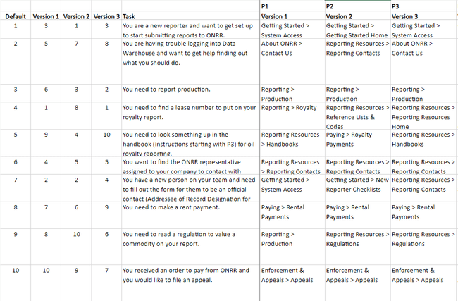
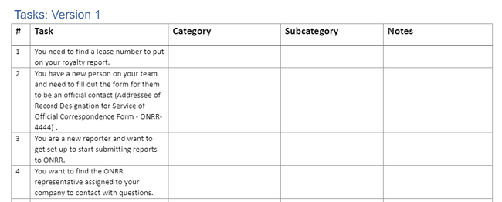
Notetaking
We started by recording categories in a spreadsheet, but found it difficult to work quickly.
We pivoted and switched to taking notes in a document.
Then we consolidated findings across participants in a spreadsheet.
Spreadsheet notes
Document notes

Slide 52

Tree testing analysis

Slide 53
Sankey diagrams
After summarizing the findings, we used Sankey diagrams to show how users navigated the tree.
The visualizations illustrate which tasks were straightforward and which ones were confusing.

Slide 54
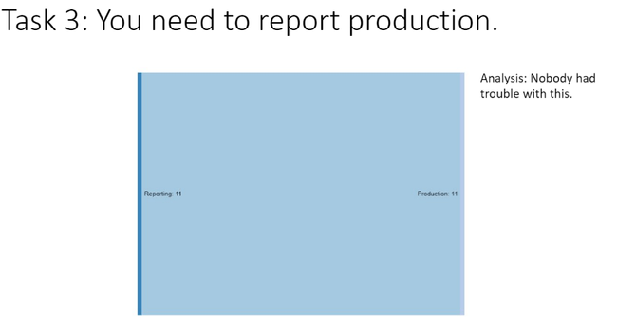
Clear tasks
We had several tasks that made us feel confident that we had the right structure in place.
The diagram below illustrates how all participants agreed on where to report production.

Slide 55
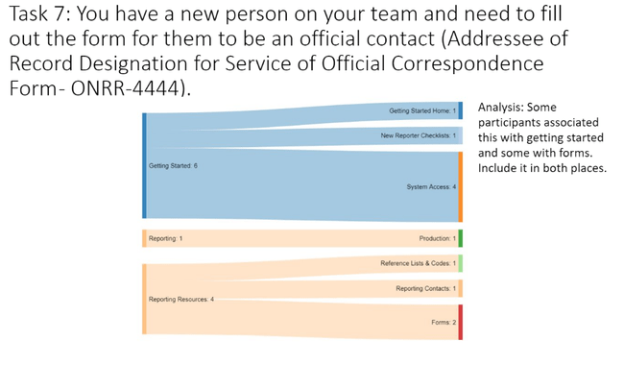
Divergent task example
The diagram below shows that participants looked for setting up a new team member. They went to the Getting Started category or Reporting Resources main category. The responses further diverged within the subcategories. Some participants were looking for a specific form and some thought it would be in Getting Started.
Our solution to this and similar issues will be to include the needed resource in more than one category.

Slide 56
Proposed structure after tree testing
Getting Started | Reporting | Guidance & Regulations? | Paying | Enforcement & Appeals | Indian Resources | About ONRR
[Need new subcategories] | Production | Valuation & Pricing |  |  | [Include Indian pricing and regulations as subcategories]
 | Royalty | Regulations
 | Solid minerals | [Or maybe combine with Valuation or Enforcement?]
 | Geothermal | Reporter letters?
 | [with reporting resources as subcategories]

Slide 57

Lessons learned from tree testing

Slide 58
Tree testing met our goals
Validate the structure that came out card sorting.
Determine whether users could find items that were hard to categorize in the card sort.
Determine if we needed to change any category labels.

Slide 59
Participants move fast
We learned how fast participants move through a tree study and learn the categories.
It underscored the importance of having few tasks and randomizing the order.
Some of our sessions only lasted 15 minutes even after troubleshooting technical issues.
We found it was helpful to have more than one person observe and take notes to record the quick responses.
The moderator learned to ask questions and slow participants down to give the note takers more time.

Slide 60
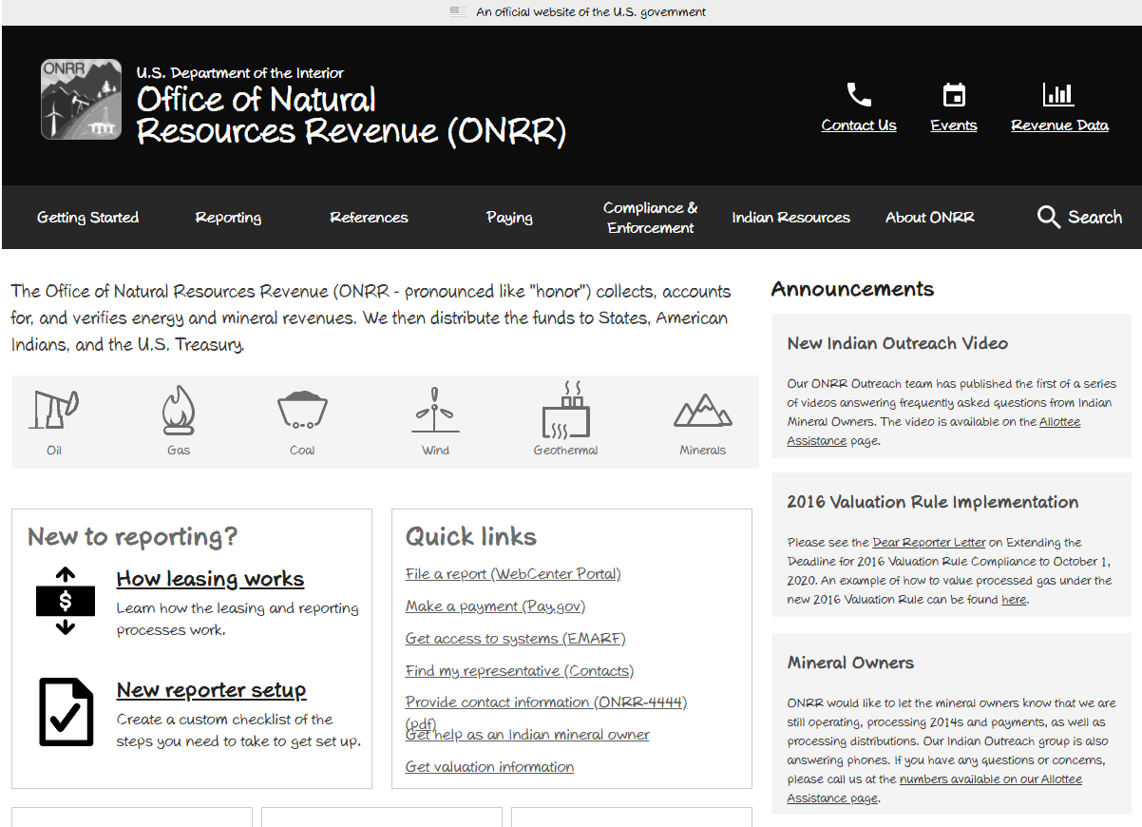
ONRR.gov future state
https://qmcq5k.axshare.com/

